Slide 1
Infernal Walls and Divine Ladders.
Crossing Borders in the Realm of the Dead in Dante and in His Visionary Precursors

Slide 2
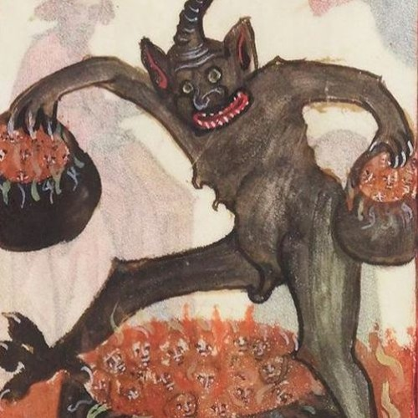
I. Vision as genre: definition and chronological-geographical dimension
The vision as a literary genre is the account of an eschatological revelation inserted within an afterlife journey, a journey offered to a chosen one, to someone in a state of near death, or to someone who requests or seeks this experience, sometimes with the aim of changing his fate, more often as a prophet who stirs the moral conscience of the listener to the story. The protagonist (the visionary or traveller) visits, in his mortal guise, the realm of immortality, where he gets to know the fate of souls after death, the understanding of which is usually done with the help of a guide. The otherworldly account is recorded directly by either the protagonist or a reliable witness to the tale.

Slide 3
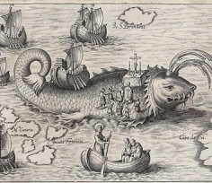
Vision and journey to the Otherworld
Caspar Plautinus
Nova Typis Transacta Navigatio: Nova Orbis India Occidentalis, 1621
According to Cesare Segre, “there are very clear differences between visions and journey accounts;” however, when analyzing the history of the evolution of visions, instead of two different genres (or in the case of voyages it is more correct to speak of a kind of narrative) we find two collectives with a large intersection. Some of the definitions of vision attempt to capture the relationship between movement / displacement on the one hand, and sight / vision on the other. According to Peter Dinzelbacher's definition, “vision is an experience whereby someone ends up from their natural environment into another space in a supernatural way.” In primitive visions we can distinguish two separate phases that together form the vision-narrative: 1) the sight, reception and understanding of the revelation; and 2) the path and journey leading up to that moment.

Slide 4
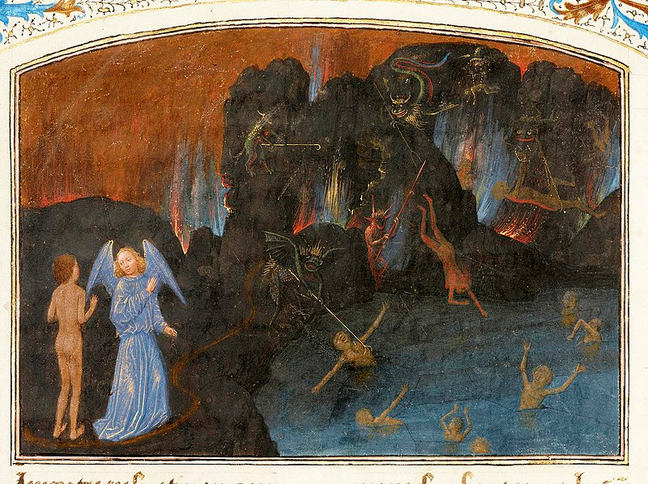
Topography of the Underworld
Marmion, Simon — Les Visions du chevalier Tondal, The J. Paul Getty Museum, Ms. 30 (87.MN.141.14), fol. 14v — The Torment of Unbelievers and Heretics — 1475
Medieval visionary authors describe the regions of the Underworld confined mostly by “natural” topographical elements and waters; i. e. mountains, valleys, pits, lakes, rivers, and only by a few artificial constructions such as walls, bridges, ladders or stairs. Dante – adapting narrative schemes and numerous elements functional to the description of an afterlife journey from the visionary repertoire – incorporates many of these topographical elements into the landscapes of his Otherworld.

Slide 5
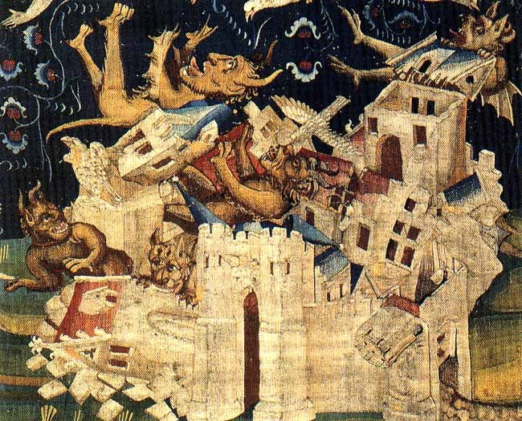
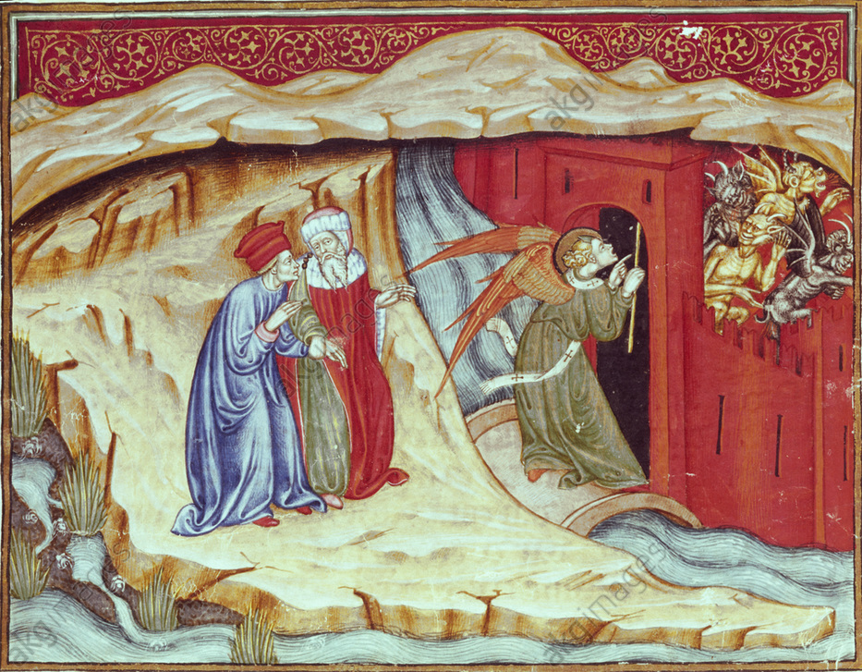
II.1. Walls
La caduta di Babilonia, arazzo XIVth century
Dante and Vergil follow the heavenly messenger to the city Dis (Inferno, 9th song). Illumination, Lombardy, c. 1440, master of the Vitae Imperatorum.
Dante Alighieri, Inferno, with a comment by GFrom: uiniforte Barzizza.Ms 76, folio 8 recto.
Imola, Biblioteca comunale.

Slide 6
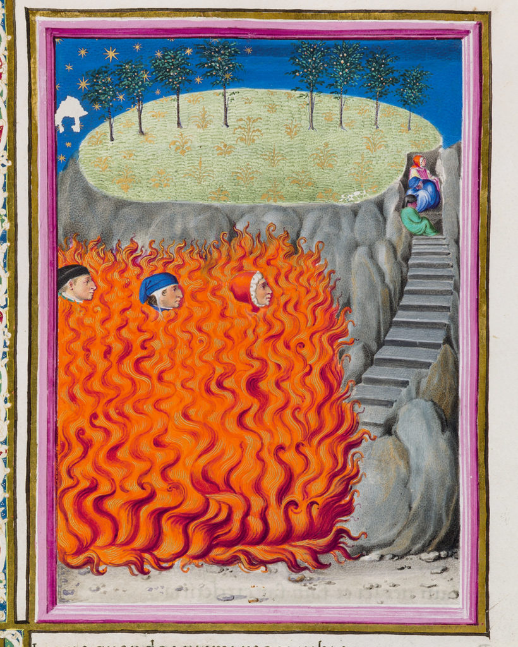
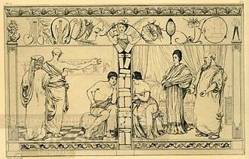
1879 etching of Pyramus and Thisbe by Max Klinger
La Divina Commedia di Federico da Montefeltro. Il Dante Urbinate. Commentario.
Miniatura tratta dalla Divina Commedia di Dante Alighieri, Ms. Urb. lat. 365, c. 175r, 1478-1482, Biblioteca Apostolica Vaticana.

Slide 7
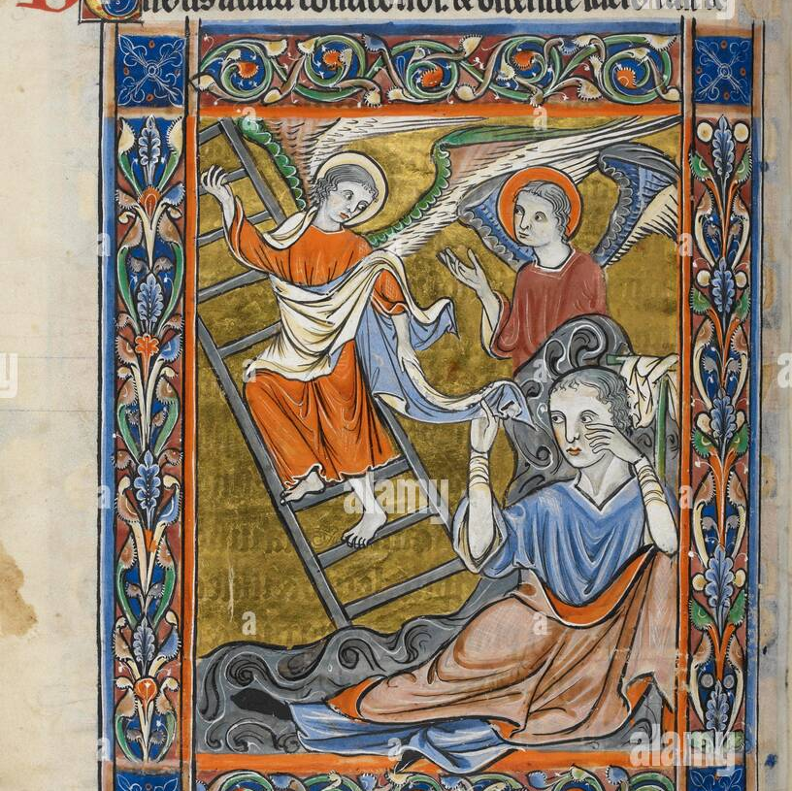
III.2. LADDERS
Jacob’s ladder (Gen. 28)
British Library
Salterio. Miniatura Salmo precedente 80. Rutland Salterio. Inghilterra [Londra?]; circa 1260. 62925, f.83v. Latina.

Slide 8
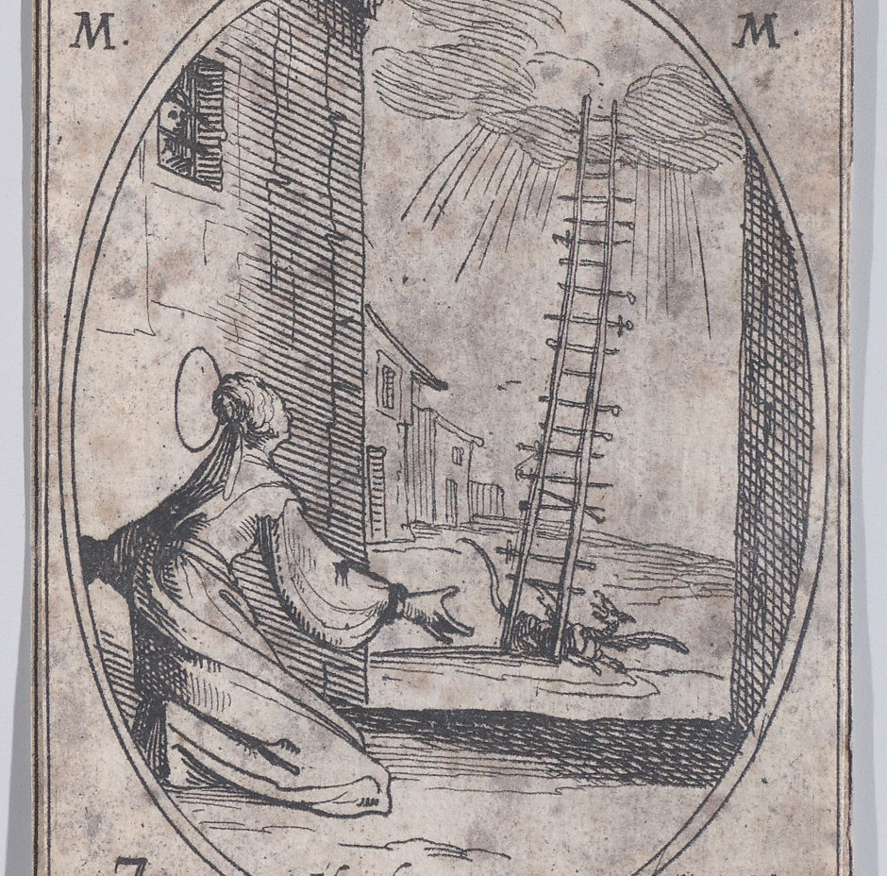
The ladder of Perpetua
1636, Jacques Callot, etching
Ste. Perpétue et Ste. Félicité, martyres (St. Perpetua and St. Felicita, Martyrs), March 7th, from Les Images De Tous Les Saincts et Saintes de L'Année (Images of All of the Saints and Religious Events of the Year)

Slide 9
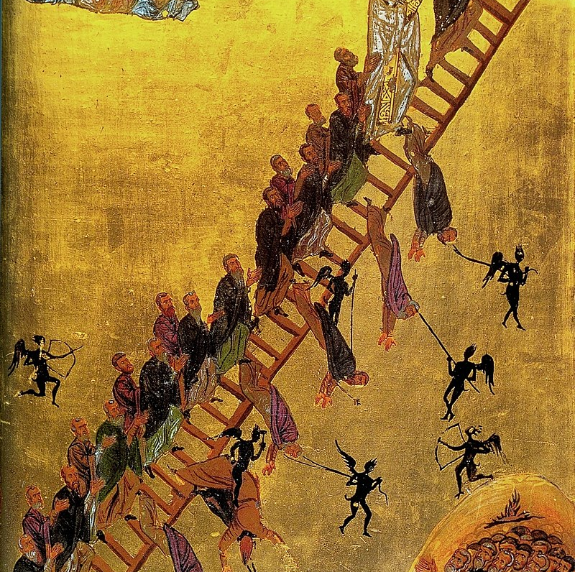
The 12th century Ladder of Divine Ascent icon (Saint Catherine's Monastery, Sinai Peninsula, Egypt) showing monks, led by John Climacus, ascending the ladder to Jesus, at the top right.

Slide 10
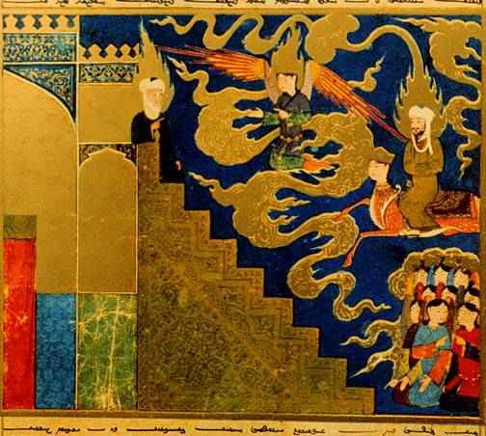
Picture: A miradj of Muhammad in a Persian manuscript (Paris)
“The stairs were made in this way: the first was ruby, the second emerald, the third snow-white pearl, and all the others of various gems, so richly decorated with pearls and colourful ornaments that the human heart could not imagine. And this was covered with a green brocade silk, richly embroidered, even brighter than emerald, and surrounded and guarded on all sides by angels.” (Scale Machometi, V. § 11)

Slide 11
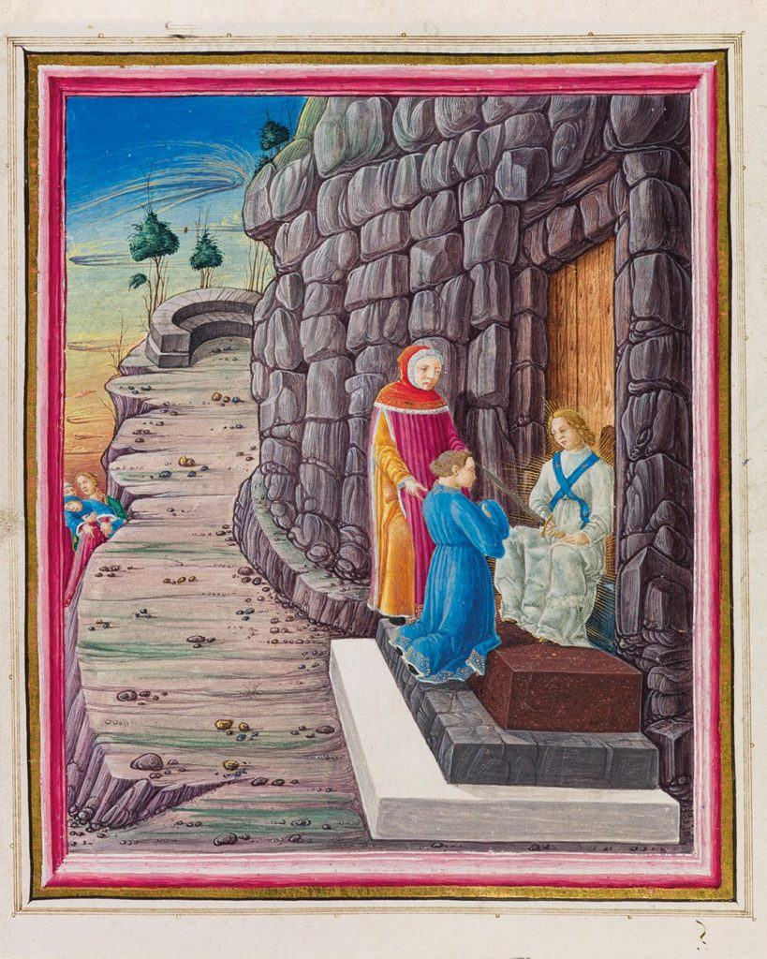
Three steps in front of the Purgatory gate: Pur. IX 94-102; PIC: La Divina Commedia di Federico da Montefeltro. Il Dante Urbinate. (Ms. Urb. lat. 365, c. 115r, 1478-1482, Biblioteca Apostolica Vaticana.)
Là ne venimmo; e lo scaglion primaio
bianco marmo era sì pulito e terso,
ch’io mi specchiai in esso qual io paio.
Era il secondo tinto più che perso,
d’una petrina ruvida e arsiccia,
crepata per lo lungo e per traverso.
Lo terzo, che di sopra s’ammassiccia,
porfido mi parea, sì fiammeggiante
come sangue che fuor di vena spiccia.

Slide 12
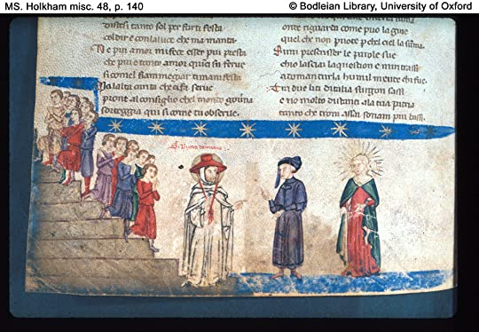
Paradiso XXI, 28-33.
Paradiso Canto XXI. “Souls Ascending and Descending the Stairs; St. Peter Damian Talks to Dante; Beatrice.”
“di color d'oro in che raggio traluce vid'io uno scaleo eretto in suso tanto, che nol seguiva la mia luce. Vidi anche per li gradi scender giuso tanti splendor, ch'io pensai ch'ogne lume che par nel ciel, quindi fosse diffuso.” (Par. XXI, 28-33; emphases mine) | I saw a ladder, the color of gold struck by the sun, erected upward so far that my light could not follow it. And I saw coming down by its degrees so many splendors that I thought every light that shows in the heaven must be poured out from there. (Robert Durling trans.)

Slide 13
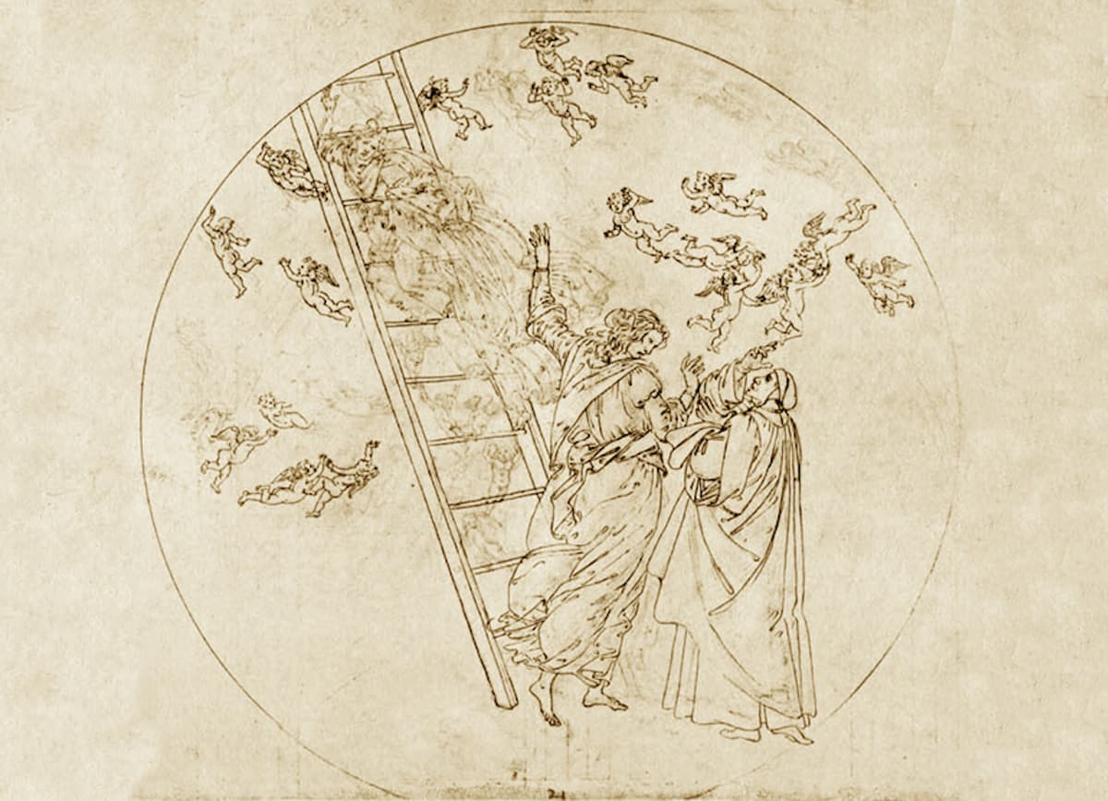
Par. XXII, 100-105.
Pic: Sandro Botticelli, Divina Commedia, ca. 1492-95
„La dolce donna dietro a lor mi pinse con un sol cenno su per quella scala, sì sua virtù la mia natura vinse; né mai qua giù dove si monta e cala naturalmente, fu sì ratto moto ch'agguagliar si potesse a la mia ala.” (Par. XXII, 100-105) | My sweet lady impelled after them up that ladder with e mere sign, her power so overcame my nature, nor down here, where we mount and descend naturally, has there ever been so rapid a motion as could equal my wing.

Slide 14
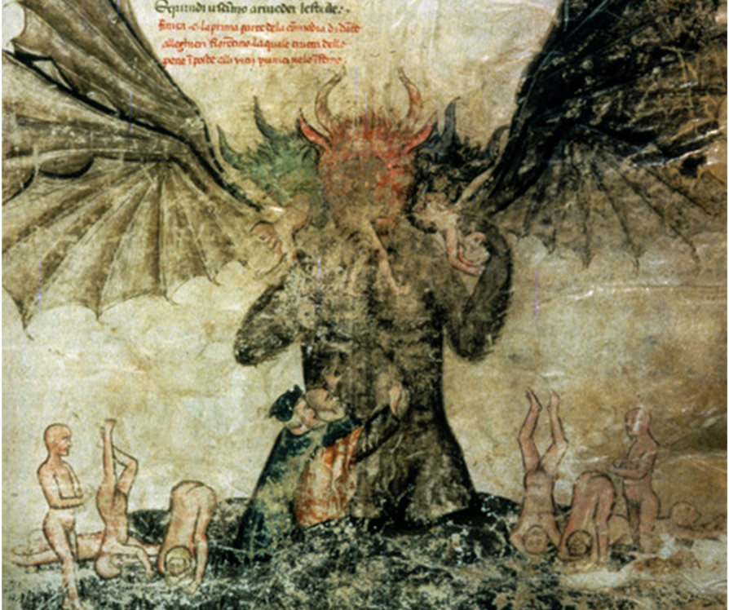
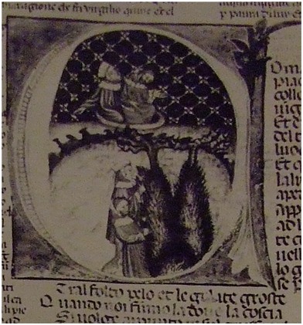
Lucifer’s body as a ladder: New York, Morgan MS 676, 47r.
London, British Museum, Add. 19587, 58r.

